Slide 1
Number Type In Detail

Slide 2
Declaring Floating point value in JavaScript :-
var x = 5.78945146;
console.log(x.toFixed(2));
Output: “5.78”
Returns a String value.

Slide 3
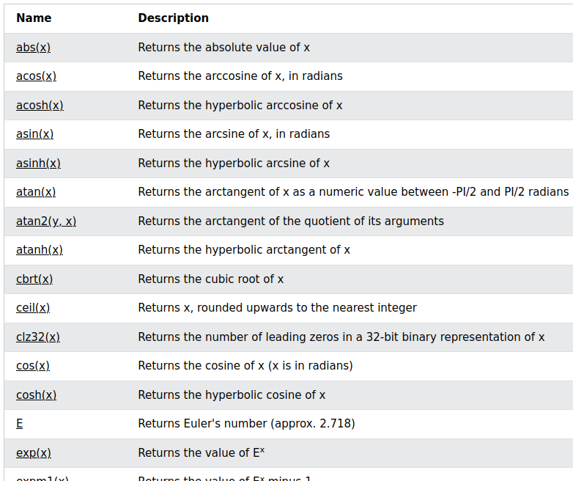
Math library of JavaScript
Ref: https://www.w3schools.com/jsref/jsref_obj_math.asp

